Slide 1
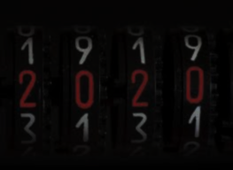
Critical Analysis
A Presentation by :
| Mohammad Anas | Fatima Azfar |

Slide 2
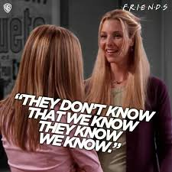
SO WHAT DO YOU THINK IS OUR TOPIC TODAY?
*yes we know that you know but we’re still going to ask it anyway XD*

Slide 3
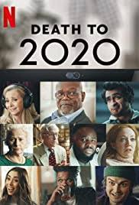
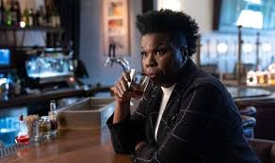
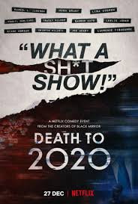
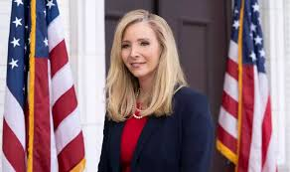
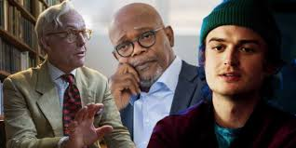
YES! IT’S A NETFLIX ORIGINAL MOCKUMENTARY CALLED “DEATH TO 2020”
Directed by | Al Campbell Alice Mathias
Produced by | Charlie Brooker
Written by | Charlie Brooker

Slide 4
This mockumentary is basically about all the events that occurred in the year 2020, from Australian bushfires to ‘Parasite’ winning the Oscar Award, it covers it all!

Slide 5
Lets first give you a little overview of the characters in ‘Death to 2020’

Slide 6
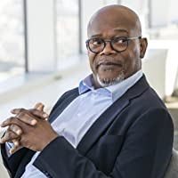
Dash Bracket is played by Samuel L.J who is using sarcasm to describe the events of 2020.

Slide 7
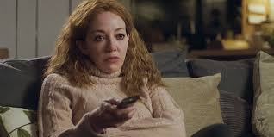
Diane Morgan portrays Gemma Nerrick, an "average citizen" whose commentaries reveal that she lost touch with reality in 2020 along with her boyfriend.

Slide 8
Leslie Jones portrays Dr Maggie Gravel, a behavioral therapist who doesn’t really like humans.

Slide 9
Lisa Kudrow portrays Jeanetta Grace Susan who depicts the typical government officials who are fond of changing their statements every minute.

Slide 10
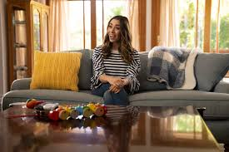
Kathy Flowers is played by Cristin Milioti who was portraying the typical racist middle-aged women who got viral in 2020 and also were called out as ‘Karens’.

Slide 11
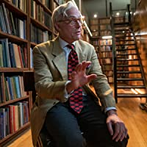
Hugh Grant breaks out his snootiest British accent to play Tennyson Foss, a history professor without much of a grip on what "history" actually is.

Slide 12
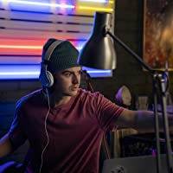
Duke Goolies portrayed by Joe Keery, can be considered a purely satirical creation, there to represent a culture which capitalizes on the latest trends to make a living, no matter how insensitive or tone-deaf he comes across.

Slide 13
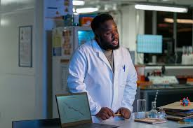
Pyrex Flask played by Samson Kayo, is a devout scientist whose statements are something no one really cares about and he has recently learnt the Floss Dance.

Slide 14
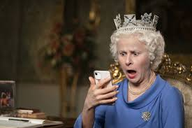
Queen Elizabeth 2 was played by Tracey Ullman and she surely mimicked the Queens’ accent to perfection.

Slide 15
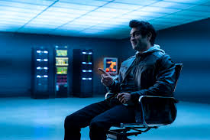
Bark Multiverse was played by Kumail Nanjiani, this character depicted a tech billionaire who got so concerned after Gretta’s speech that he got himself a soundproof bunker for when global warming takes over the world.

Slide 16
NOW LETS TAKE YOU ON A LITTLE RIDE THROUGH THE EVENTS COVERED IN THIS MOCKUMENTARY!

Slide 17


Slide 18

THE ALMOST OCCURRED
WORLD WAR 3

Slide 19
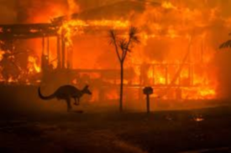
THE AUSTRALIAN BUSHFIRES

Slide 20

THE ‘COVID-19’ PANDEMIC

Slide 21
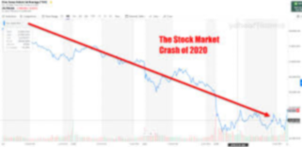
THE BIGGEST STOCK MARKET CRASH SINCE 2008

Slide 22
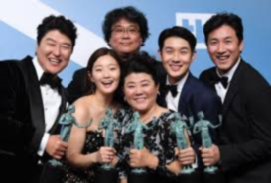
THE FIRST EVER NON-ENGLISH MOVIE ‘PARASITE’ WINS OSCAR

Slide 23
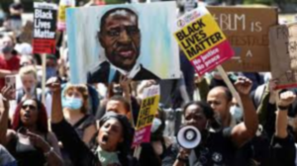
THE BLACK LIVES MATTER MOVEMENT

Slide 24
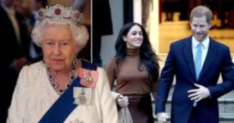
PRINCE HARRY AND MEGHAN LEAVE ROYAL LIFE

Slide 25
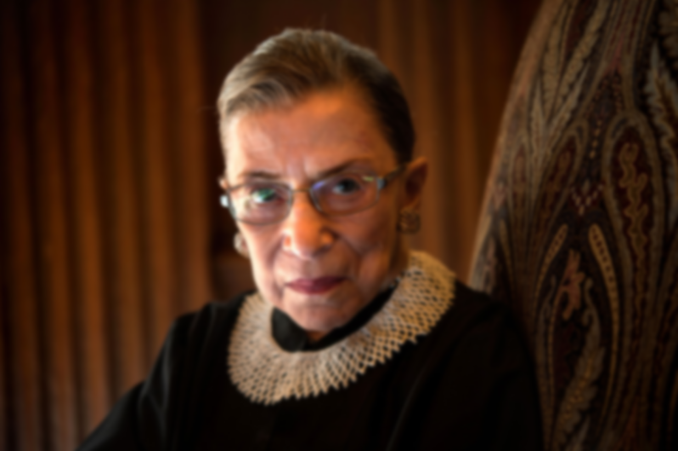
THE DEATH OF RUTH BADER

Slide 26
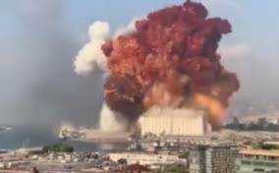
THE BEIRUT EXPLOSION

Slide 27
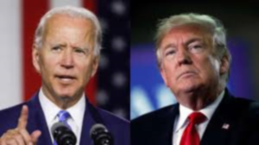
THE US ELECTIONS

Slide 28
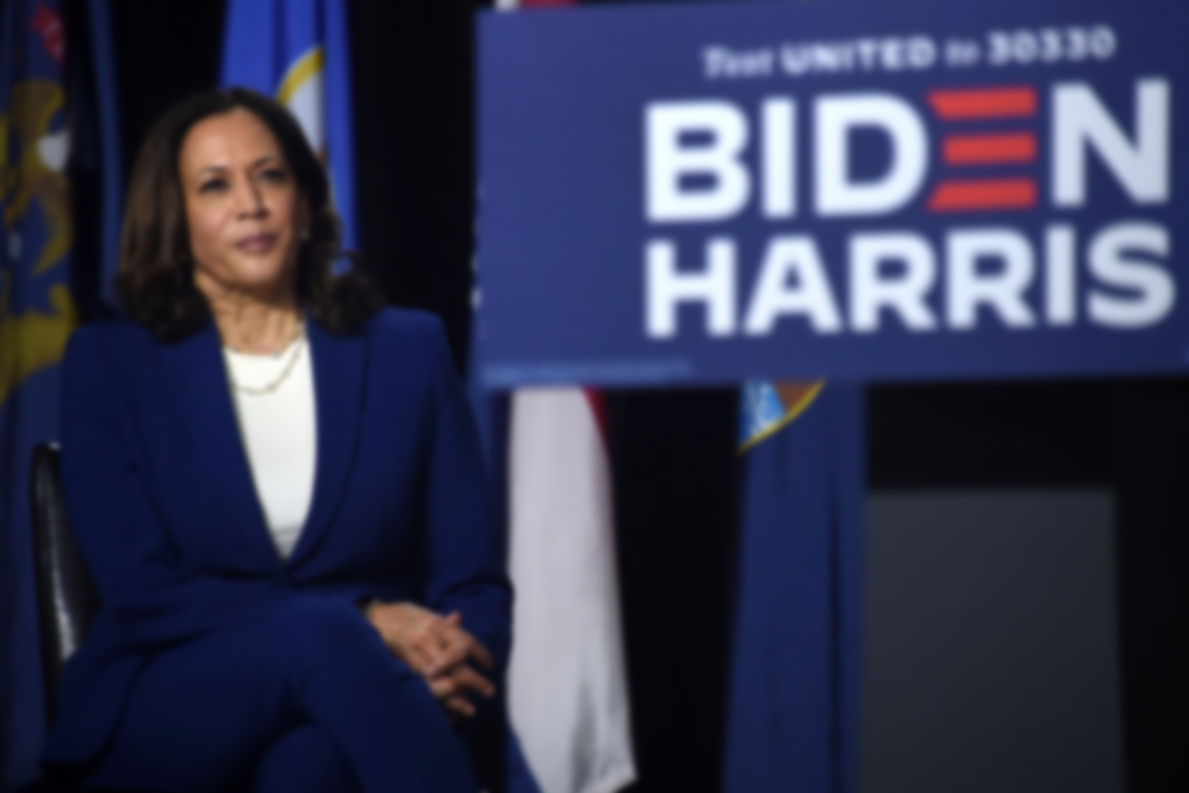
KAMALA HARRIS, FIRST EVER WOMAN OF COLOR as VP

Slide 29

COVID-19 vaccine rollout

Slide 30
It as a whole was a sarcastic, informal and humorous representation of the events of 2020 and its mere purpose was to entertain.
Well, because that’s what a mockumentary is!

Slide 31
It was an impactful watch as the movie certainly reached its purpose which was to summarize the events of 2020 in a rather humorous way.

Slide 32
This year had many unsettling events globally that are worth mentioning but this mockumentary mainly covers the events which took place in America.

Slide 33
Thank You for your attention ☺

